Slide 1

Continuous Dev ps
Michael Irigoyen
Software Engineer III
Team Trogdor
mirigoyen@accusoft.com

Slide 2

About Me
I am Michael Irigoyen.
UI/UX design for 15+ years
PHP for 13+ years
JS/ES for 10+ years
Node.js for 2+ years

Slide 3

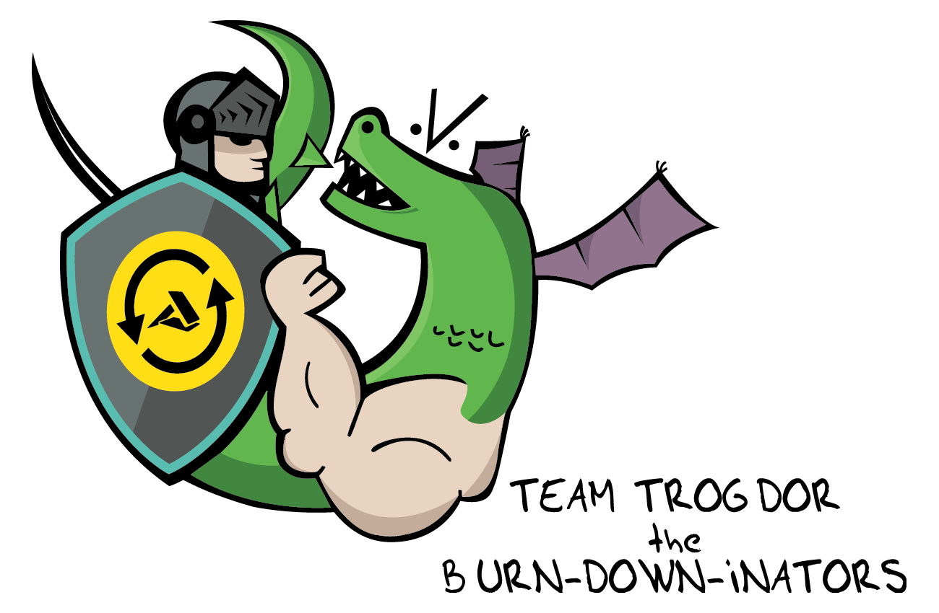
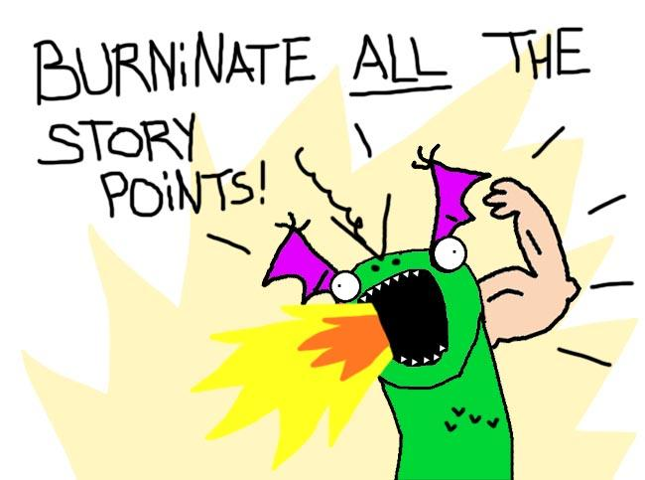
That looks really good coming out of the back of his neck there...

Slide 4
It is not the strongest of the species that survive, nor the most intelligent, but the one most responsive to change.
“
”
- Charles Darwin

Slide 5
What is DevOps?

Slide 6

I do not think it means what you think it means.

Slide 7
Responsibilities of Dev & Ops
Dev
Generate change
Create new features
Modify existing functionality
Ops
Create stability
Improve architecture
Enhance infrastructure
QA
Assess customer requirements
Determine quality standards
Ensure quality standards are met

Slide 8
Responsibilities of Dev & Ops
… We have some issues.
Dev
Generate change
Create new features
Modify existing functionality
Ops
Create stability
Improve architecture
Enhance infrastructure
QA
Assess customer requirements
Determine quality standards
Ensure quality standards are met

Slide 9
Introducing DevOps

Slide 10

DevOps silos are bad and you should feel bad!

Slide 11
What DevOps is not...
DevOps is not a siloed entity, working on assumed (or communicated) solutions to bridge the gap between developers/QA and operations staff.
Operations
Development
DevOps
QA

Slide 12
What is DevOps?
DevOps is a cultural shift between development, operations, and testing. It emphasizes Quality of Life improvements at all stages of the software delivery process.
Development
QA
DevOps
Operations

Slide 13
DevOps Culture
DevOps was started as a grassroots movement by developers, engineers, and sysadmins
Much of DevOps is modeled around Agile principles

Slide 14
Traditional DevOps
Establishes communication between, or combines, the teams involved in the software delivery process
Goal is to establish an environment where releasing your application is quicker and more reliable
Continuous integration/delivery is typically the result of a DevOps culture
Established DevOps culture tends to stagnate
PLAN
CREATE
RELEASE
CONFIGURE
DEV
OPS
VERIFY
PACKAGE
MONITOR

Slide 15
Traditional DevOps
Establishes communication between, or combines, the teams involved in the software delivery process
Goal is to establish an environment where releasing your application is quicker and more reliable
Continuous integration/delivery is typically the result of a DevOps culture
Established DevOps culture tends to stagnate
PLAN
CREATE
RELEASE
CONFIGURE
DEV
OPS
VERIFY
PACKAGE
MONITOR

Slide 16

DevOps needs buy-in from Managers, Project Managers, and/or Executives to be successful.

Slide 17
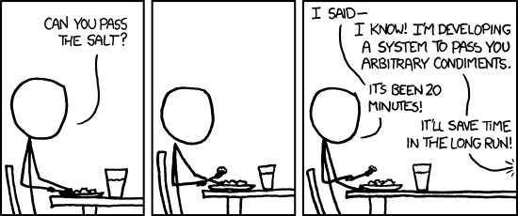
Why does traditional DevOps stagnate?
DevOps related stories often deprioritized over product features
It becomes harder for Project Managers to visualize the benefits of DevOps-related tasks
Continuous Integration/Delivery is established and functioning
Short-term ROI becomes habit
Agile states you should do the minimum to meet acceptance criteria
http://xkcd.com/974/

Slide 18
Continuous Dev ps

Slide 19
What is Continuous DevOps?
Continuous DevOps is the natural progression of DevOps culture which accentuates prioritizing the improvement of the development pipeline proactively while working on other related tasks.

Slide 20
Give me six hours to chop down a tree and I will spend the first four sharpening the axe.
“
”
- Unknown

Slide 21

Sharpening the Axe
Employ toolsets
Automate processes
Increase confidence
Improve visibility
Utilize retrospectives
Prepare for change

Slide 22
Employ Toolsets
Tools are a huge part of successful DevOps
Dev Tools: Linters, Virtual Environments
QA Tools: Static/Dynamic Code Analysis
Ops Tools: Job Runners, Notifications
Every tool can provide some benefit to all aspects of of the development cycle

Slide 23
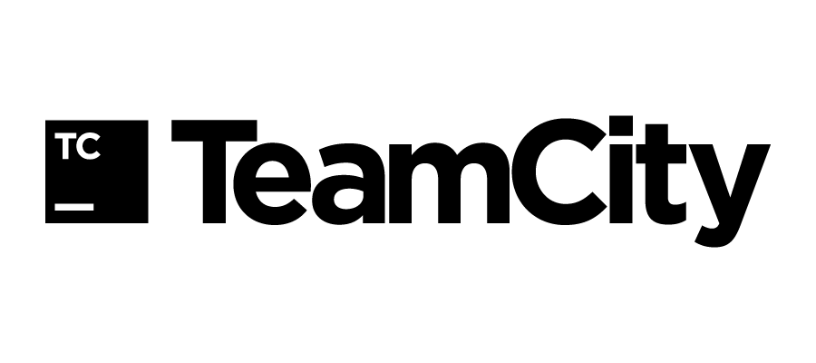
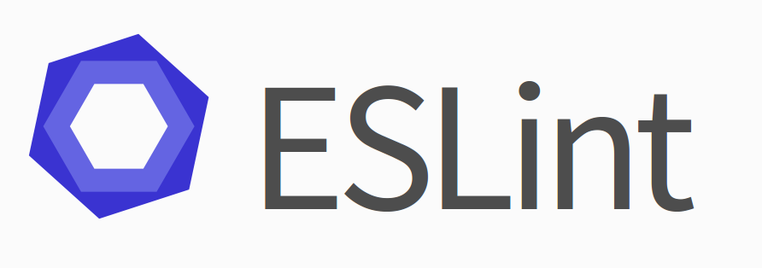
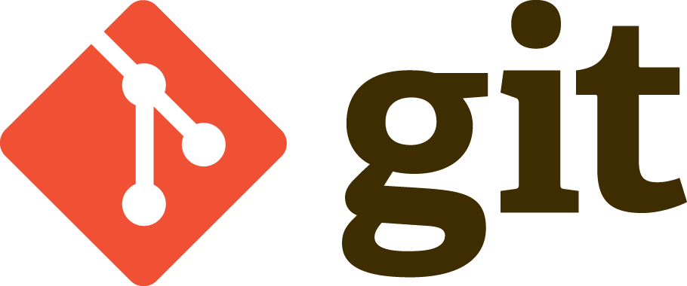



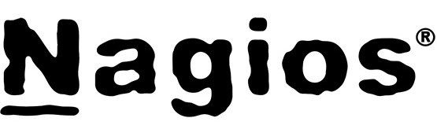




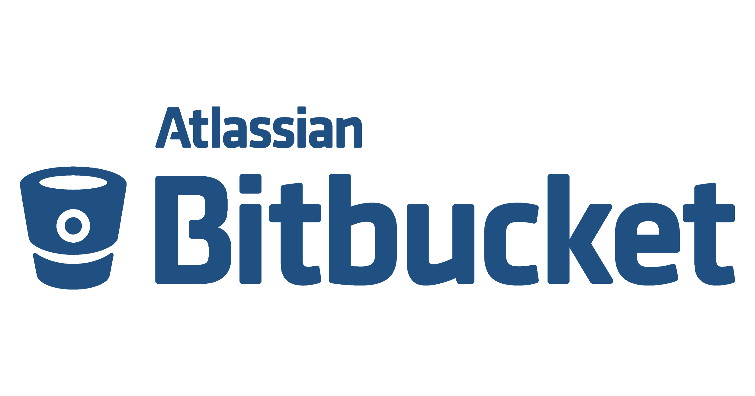


There are thousands of tools you can utilize.
(And you probably are using some!)

Slide 24



Toolsets at Accusoft
Team Trogdor
QA
Atom, Docker, ESLint, Git, Githooks, HipChat, Locust, Mocha, Selenium, Vagrant
All these tools used by everyone on the team.
Node.js
Ecosystem
Development
Operations
Atom, Docker, ESLint, Framing.js, Git, Githooks, Gulp, HipChat, NPM, Vagrant
Atom, AWS, Bash, Docker, Git, Gulp, HipChat, TeamCity, Zabbix

Slide 25
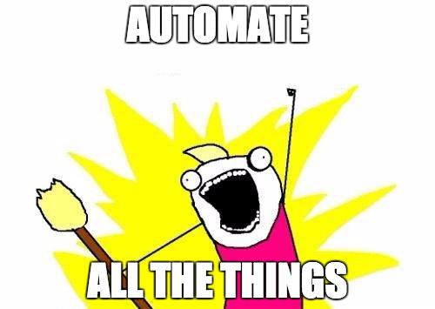
Every part of the development cycle can be automated in some way
Asset compiling
Test running
Package building
Server deployments
Smoke Testing
Auto-scaling
Health reporting
……
Automate Processes

Slide 26
Automation at Accusoft
Use Case: Git Hooks - Team Trogdor
Problems
Lots of repos, lots of changes… Hard to track dependency changes
Extremely difficult to stay on top of node module security issues
New code isn’t instantly applied if the node service is already running
Solution: husky (https://github.com/typicode/husky)
"scripts": {
"test": "istanbul cover _mocha --report html",
"security": "./node_modules/nsp/bin/nsp check",
"prepush": "npm test && npm run -s security",
"postmerge": "git diff-tree -r --name-only --no-commit-id ORIG_HEAD HEAD | grep -E --quiet \"package.json\" && eval \"npm install && npm prune\"; npm run restart",
"restart": "vagrant ssh -c \"sudo docker exec -t dtm bash -c \\\"runner stop workflow-manager; runner start workflow-manager\\\"\" || true"
}

Slide 27
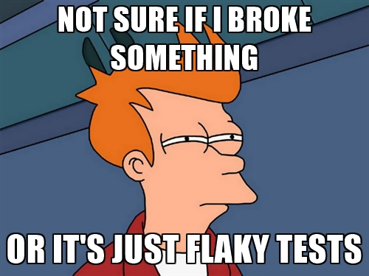
When you’re confident about your codebase, you can deploy more frequently
Make frequent, small, independent, and easily testable changes
Identify and fix/remove flaky tests
Constantly be deploying, even if those deployments don’t make it into production
Increase Confidence

Slide 28
Confidence at Accusoft
Use Case: Automated Tests - Team Trogdor
Problem
Reports of a third-party dependency intermittently working
First Attempt
Increase logging and notifications around the dependency
Better... but not ideal because it happens so infrequently
Solution
Automated Tests! Isolated and began running test every 10 minutes
With extended logging, able to provide plenty of debug info to third-party
Discovered other issues with our system which we were able to harden
Built-in retries
Longer timeouts

Slide 29
Improve Visibility
Frequent releases means things are changing constantly
Legacy monitoring tools cannot meet the new challenges
Debugging in production is hard, if not impossible
Storage is cheap: log, log, log!
Create easy access points into logs at problem points
Constantly report status, changes, errors in central locations

Slide 30
Visibility at Accusoft
Product Dashboards
Goal
Increase response times on critical issues with the application
Solution
Utilize Google Cast device in central meeting space
Built a Node/React app to stream to device when not in use
Display real-time status of metrics we care about
Production Stack Age
Production/QA Stack Health
Project Build Status
Automated Test Status
Open Merge Requests
Sprint Goals

Slide 31
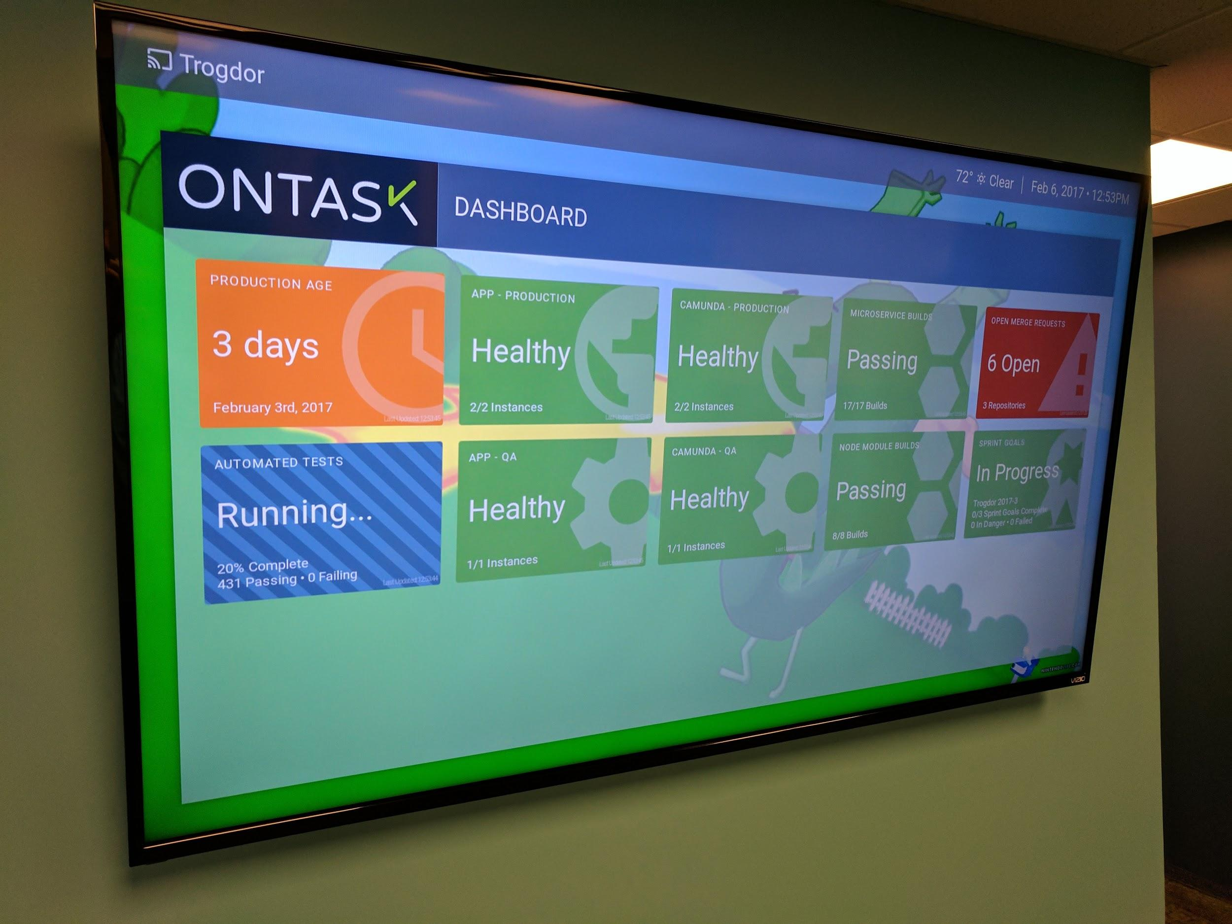

Slide 32
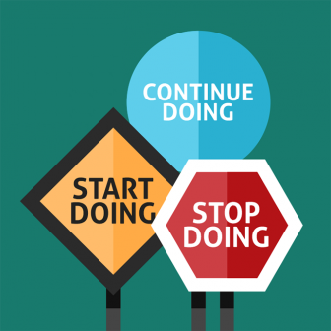
Retros are a place to promote continuous improvement
You’re already discussing how to advance as a team
Determine how to boost your CI/CD processes
Examine changing or adding tools
Develop strategies for eliminating technical debt
Utilize Retrospectives

Slide 33
Retrospectives at Accusoft
Reducing Technical Debt
Where does technical debt come from?
Not defining best practices across the team (or adhering to them)
Inexperienced with technologies in use
Rushing prototype code into feature code
Our Strategy: Quarterly Hack-a-thons
Two/three days of do-whatever-you-want time, as long as it can benefit your team/company in some way
Time to explore new technologies/brush up on ones you’re using
Attack known technical debt that may not be addressed in a timely manner
All teams come together to share what they did and what they learned

Slide 34
Retrospectives at Accusoft
Hack-a-thon Examples
CSS style reference website for our UI developers
Exploring React/Redux for event driven web applications
Programming a drone to react to TeamCity build failures
Migrating microservices into a new framework
Log analyzer and visualizer
Cross-technology query engine (for querying MySQL and DynamoDB)
Log generating middleware for systems that don’t provide good logs
Visibility dashboards

Slide 35

Prepare design documents for new features
Write small, functional, and easily testable code
Make smart coding decisions
Consider consolidating programming languages across delivery borders so anyone can attack any problem
Avoid using prototyped code in production
Don’t be like Garth!
Prepare for Change

Slide 36
Preparing for Change at Accusoft
Making smart tooling decisions
Problem
Spend large amounts of time discussing and deciding on a toolset
Get extremely invested before learning the tool is not optimal
Cannot convince PM to spend more time replacing the toolset
Solution
Stay light with our tool selection
Prototyping with various tools across the same product
Attempt to abstract interaction with the tool into a generic layer
Easier to switch if a better tool/version comes out

Slide 37
Summary
Continuous DevOps is the practice of keeping your delivery pipeline sharp
Employ toolsets
Automate processes
Increase confidence
Improve visibility
Utilize retrospectives
Prepare for change
}
All equally important!

Slide 39
mirigoyen@accusoft.com
@mririgo

